Slide 1

Intelligent Business Intelligence Dashboard for Superstore Sales
From Data to Decisions: A Power BI Journey
Presented by: Apex Team

Slide 2

Why We Need This Dashboard
Navigating a Sea of Data: The Challenge
The Problem: Superstore generates massive daily transactional data, creating a complex web of information.
Stakeholders are currently reliant on disconnected spreadsheets and raw data, leading to significant inefficiencies.
Inability to Monitor KPIs
Difficulty Identifying Trends
Without real-time insights, tracking key performance indicators is a constant struggle.
Pinpointing sales trends and top-performing products or regions remains elusive.
Time-Consuming Reporting
Manual reporting processes consume valuable time and resources that could be better spent on strategic initiatives.
The Bottom Line: We are missing critical opportunities for growth and efficiency in a competitive market.

Slide 3
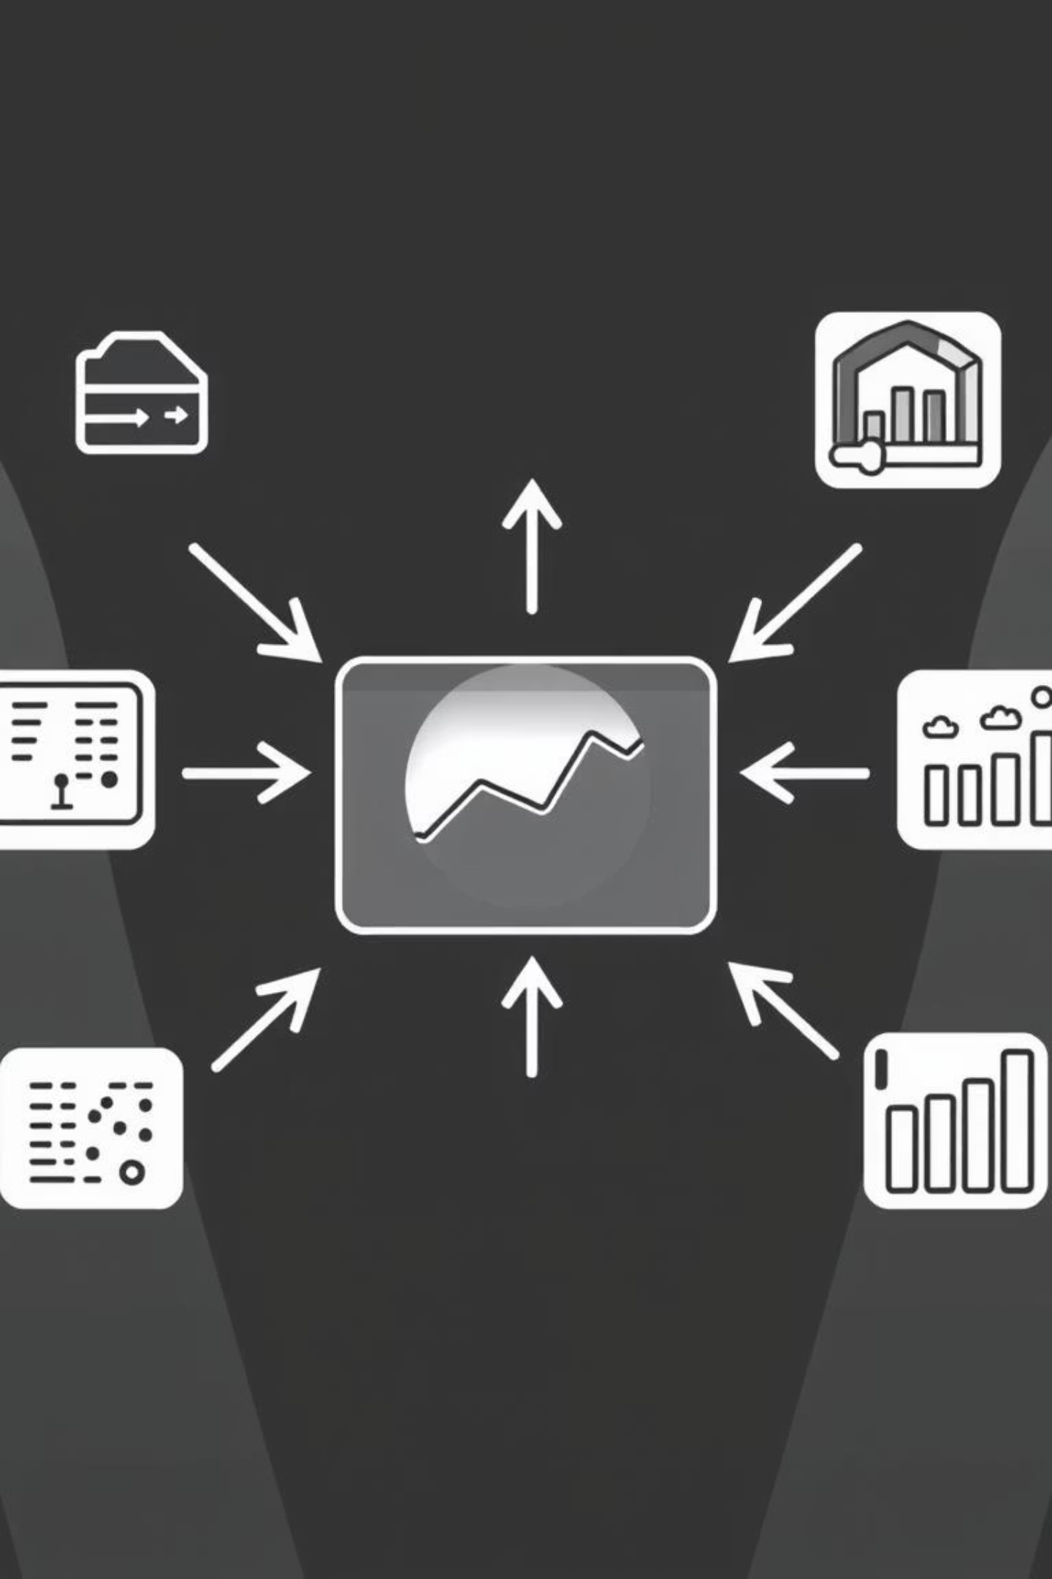


A Single Source of Truth
Our Solution: The Power BI Dashboard
We developed a centralized, interactive Power BI dashboard to visualize all key sales data.
This innovative solution transforms complex, raw data into actionable insights, empowering our teams.
Data-Driven Decisions
Enables informed decision-making for managers, analysts, and the entire sales team.
360-Degree View
Provides a comprehensive overview of business performance from every angle.

Slide 4





What We Set Out to Achieve
Project Goals & Key Objectives
Overview
Track Total Sales, Orders, and Average Order Value (AOV) in real-time to assess performance.
Regional Analysis
Compare and analyze performance across different states and regions to optimize marketing strategies.
Product Analysis
Identify top-selling categories and underperforming products to manage inventory effectively and inform purchasing.
Order Details
Analyze customer segments to understand purchasing behavior and pinpoint high-value clients for targeted engagement.

Slide 5
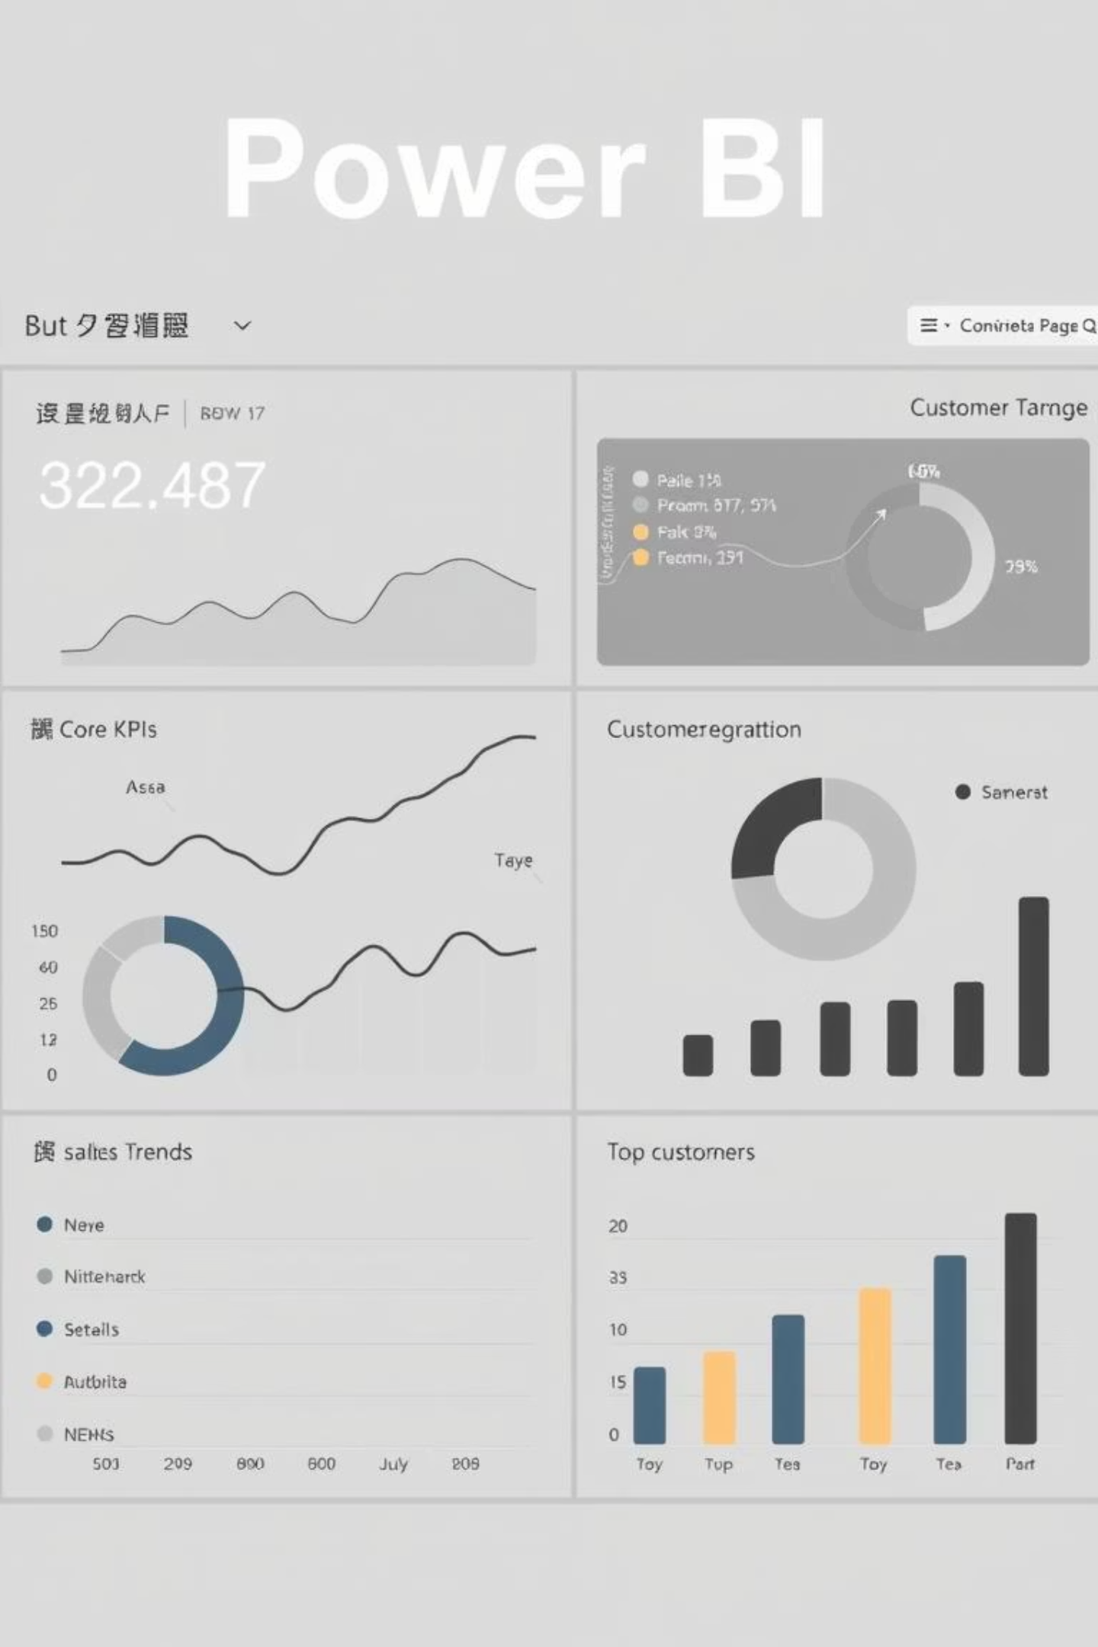
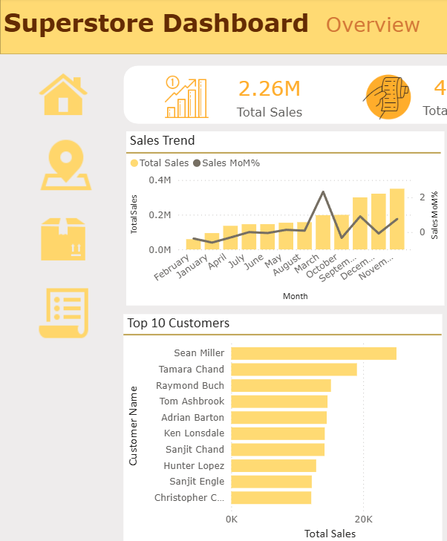
The Executive Summary
A Glimpse of the Dashboard: Overview Page
This is the heart of our dashboard, providing an immediate health check of the entire business.
At a glance, stakeholders can quickly understand critical aspects of our operations.
Core KPIs: Displays Total Sales, Total Orders, Average Order Value (AOV), and Total Customers.
Sales Trends: A dynamic line chart illustrating performance evolution over time.
Customer Segmentation: A clear donut chart breaking down customer segments: Consumer, Corporate, and Home Office.
Top Customers: A concise bar chart highlighting our most valuable and loyal clients.

Slide 6
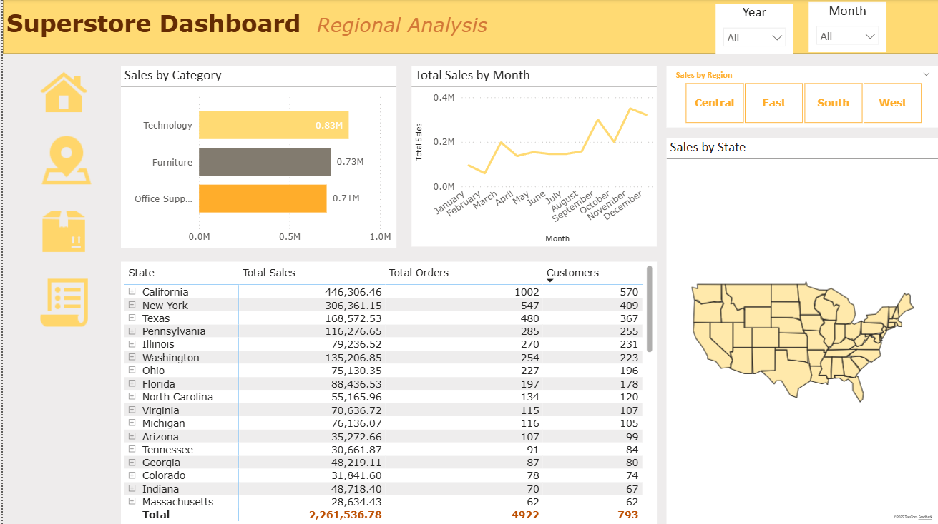
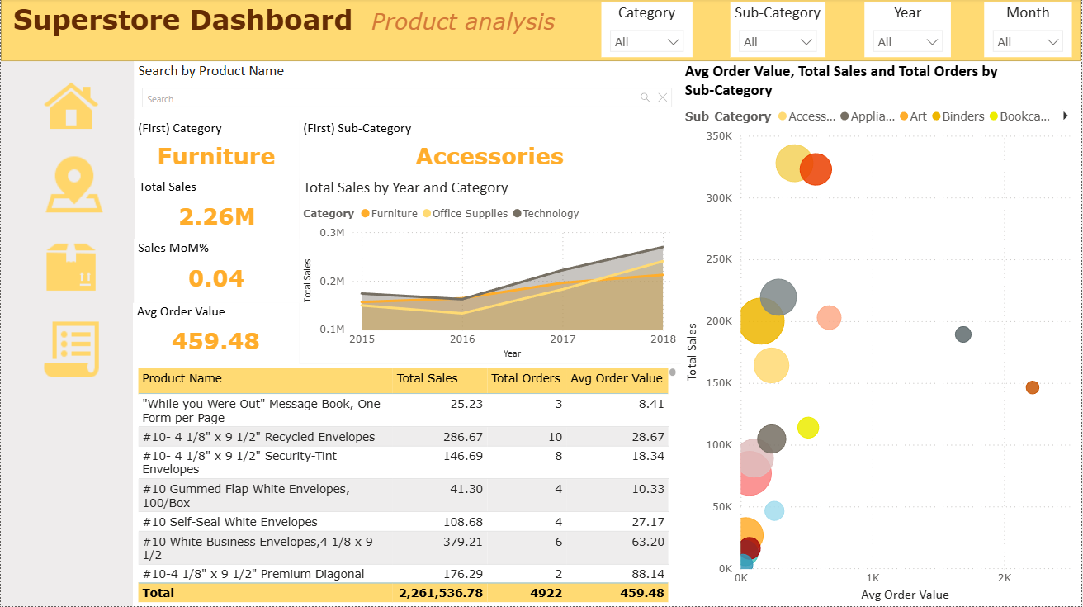
Uncovering Geographic & Product Trends
Diving Deeper: Regional & Product Analysis
Regional Analysis
Product Analysis
This page utilizes an Azure Map to vividly visualize sales distribution and performance across various regions.
Features a compelling Scatter Plot (Sales vs. Profit) and detailed category breakdowns for granular product insights.
It helps us answer critical questions like: "Where are our most profitable markets and what geographical areas need more attention?"
This analysis helps us determine: "Which products drive the most revenue and profit, and where are potential opportunities for optimization?"

Slide 7
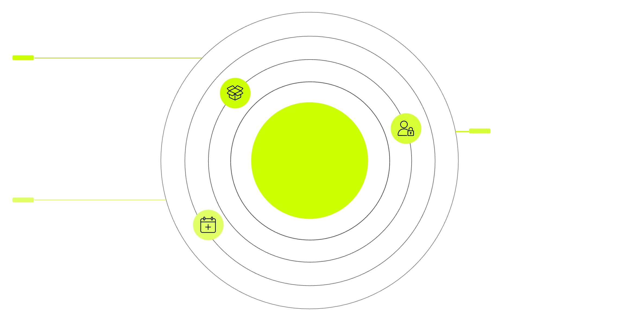



Built on a Solid Foundation
Behind the Scenes: Robust Data Architecture
Dim_Product
Product attributes and categories
Superstore_Sales
Dim_Customer
Customer profiles and segments
Dim_Date
Dates, fiscal periods, holidays
We leveraged a Star Schema data model for its optimal performance, scalability, and simplified analytical capabilities.
This architecture is designed for efficient data retrieval and powerful reporting.
Core Components:
Key Benefits:
Fact Table: Superstore_Sales - The central repository for all core transactional data.
Faster Query Performance: Expedited data retrieval for quicker insights.
Dimension Tables: Dim_Product, Dim_Customer, Dim_Date - Providing contextual attributes for analysis.
Simplified DAX Calculations: Streamlined logic for powerful analytical expressions.
Easy Maintenance & Updates: A robust yet flexible structure for ongoing management.

Slide 8


The Logic That Powers the Insights
The Engine Room: Smart Calculations with DAX
All key performance indicators (KPIs) within the dashboard are meticulously crafted and driven by powerful DAX (Data Analysis Expressions) formulas.
Total Sales
Total Orders
Total Sales = SUM('Sales'[Sales Amount])
Total Orders = DISTINCTCOUNT('Orders'[Order ID])
Sales MoM%
Sales MoM% = DIVIDE( ([Total Sales] - [Sales Previous Month]), [Sales Previous Month])
Best Practices: We strictly adhered to best practices by using a central _Measure table for organizational clarity and the DIVIDE() function to ensure error-free calculations, particularly with potential division by zero scenarios.

Slide 9

A Well-Executed Plan
Project Management: On Time and On Track
Planning
Analysis
Design
Implementation
The project was executed following a structured 5-phase timeline over a concentrated 2-month period.
This rigorous approach ensured meticulous attention to detail and adherence to our ambitious schedule.
01
02
03
Planning & Requirements
Data Analysis & Cleaning
System Design & Modeling
Defining scope, objectives, and gathering stakeholder needs.
Thorough examination and preparation of raw data for accuracy and usability.
Architecting the data model and dashboard layout for optimal performance.
04
05
Dashboard Implementation
Testing & Deployment
Building out visualizations, measures, and interactive elements within Power BI.
Rigorously testing for functionality and accuracy, followed by strategic deployment.
This structured methodology ensured we delivered a high-quality product, on schedule, and aligned with all project goals.

Slide 10

Thank You

